Slide 1

Fraud detection in online transactions
Using machine learning models to predict whether a transaction is legitimate or fraudulent
Notes:
The growth of ecommerce and online shopping in recent years has opened up opportunities for online fraud like we’ve never seen before. It is more important than ever to develop strong fraud prevention technology to protect customers and merchants from online fraudsters. In this project, we build a machine learning model that takes in customer and transaction information to predict whether a transaction is legitimate or fraudulent. Using this model, we hope to increase revenue by approving more good orders, and decrease chargebacks, or the cost that merchants need to pay back from incorrectly approving a fraudulent order.

Slide 2

DATA
Notes:
The first step in building our model is to collect data. This project uses a dataset from Kaggle, which contains the information of 150,000 online transactions from October of 2020 to October of 2021, and whether each transaction was legitimate or fraudulent.

Slide 3
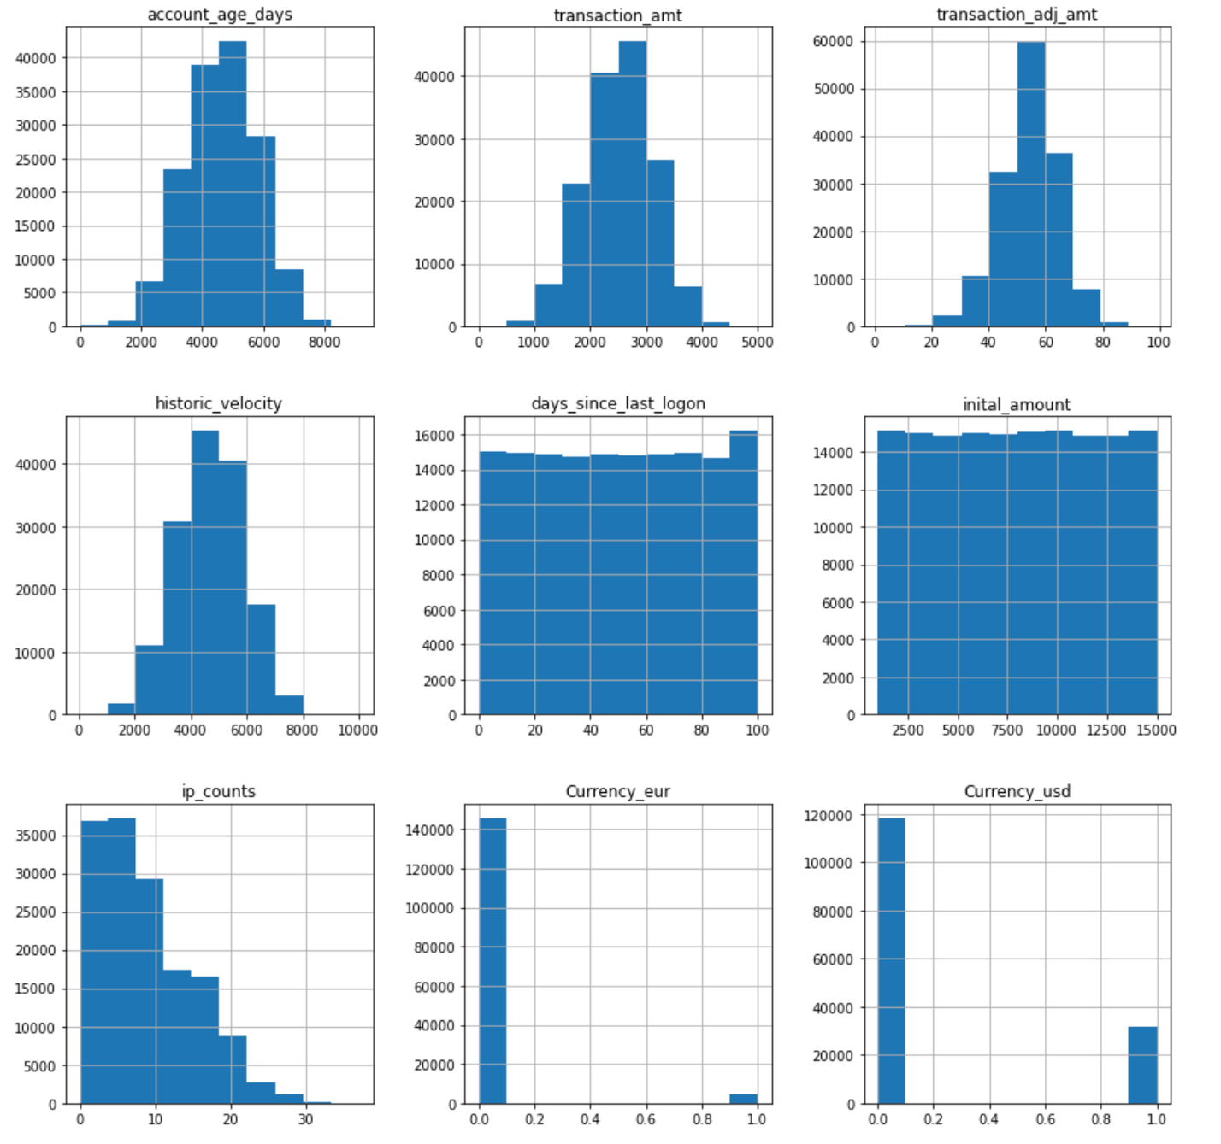
DATA
Notes:
After resolving null values and dropping irrelevant columns, we take a look at the distributions of the final 9 input features. We created 3 new columns – ip_counts, Currency_eur, and Currency_usd. Ip_counts calculates the total number of times a certain IP address has shown up in the past, to account for recurring users. Currency_eur and Currency_usd are dummy variables created from the currency column – the 3rd dummy variable, Currency_cad was removed to prevent correlation.

Slide 4
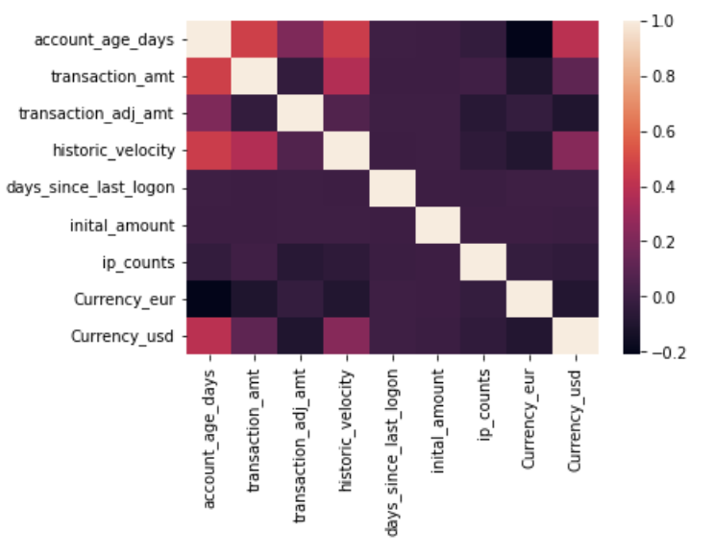
DATA
Notes:
The correlation matrix of the input variables shows that in general, the features are not correlated with each other. There may be a slight correlation between account age and the transaction amount and historic velocity, which makes sense since the older the account, the more transactions associated with it. But for the most part, all of the input variables are independent of each other.

Slide 5

MODEL
Notes:
Now that we have our input features, we are ready to tune our machine learning model. We first split our data into training and test sets, and standardize the input variables so that they are all within the same range. The targets are mapped as legitimate = 1 and fraudulent = 0.

Slide 6
Logistic Regression
Random Forest
Gradient Boosting
XGBoost
MODEL
Neural Network
Notes:
We test several classification models, including Logistic Regression, Random Forest, Gradient Boosting, XGBoost, and some Neural Network models.

Slide 7
Random Forest
Max_depth: [3, 10, 15]
Min_samples_leaf: [1, 50, 100]
N_estimators: [100]
Gradient Boosting
Max_depth: [3, 10, 1000]
Min_samples_leaf: [1, 50, 100]
N_iter_no_change: [5]
XGBoost
Max_depth: [3, 6, 10]
Min_child_weight: [1, 50, 100]
N_estimators: [100]
Neural Network
Shape of input layers: [9, 5]
# of hidden layers: [0, 1]
MODEL
Notes:
Each model is first tuned separately to find the best performing hyperparameters. As you can see here, the best hyperparameters of each model are highlighted.

Slide 8

RESULTS
Notes:
We calculate the AUC score as the metric for comparison between models. Additionally, we create a baseline model to compare our tuned models to, which is a simplified Random Forest model with a max depth of 2.

Slide 9
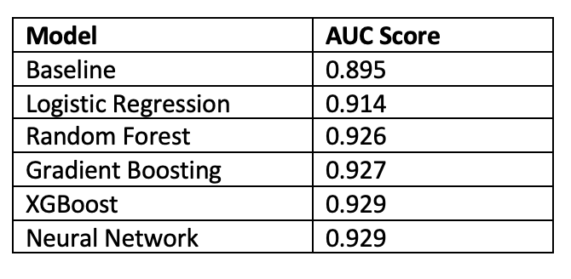
RESULTS
Notes:
Out of all the models tested, we found that the Neural Network model with 1 hidden layer resulted in the highest AUC score. Out of the tree-based models, the XGBoost model performed the best with a similar AUC score. You can see the AUC scores of all models in this table, including the baseline.

Slide 10
Approval Rate
(True Positives + False Positives) / Total
Chargeback Rate
False Positives / Total
Revenue
(True Positives / Total) * Total Volume
Missed Revenue
(False Negatives / Total) * Total Volume
RESULTS
Notes:
Finally, we calculate the business impact of the best performing models (Neural Network and XGBoost) compared to the baseline model. The metrics we want to look at are the approval rate, chargeback rate, revenue, and missed revenue.
Approval rate is defined as all approved orders over the total. Chargeback rate is defined as the percentage of fraudulent transactions that we approved over the total. Revenue is the approval volume minus the chargeback volume, or the number of correctly approved transactions over the total. And missed revenue is the number of good orders that we declined over the total.

Slide 11
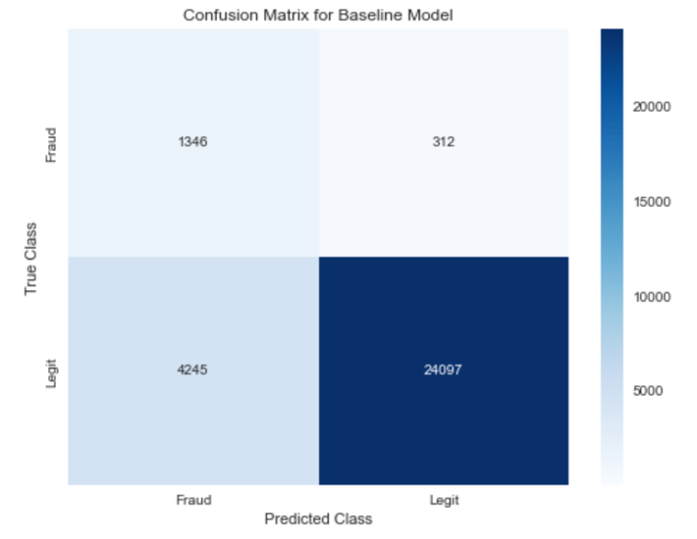
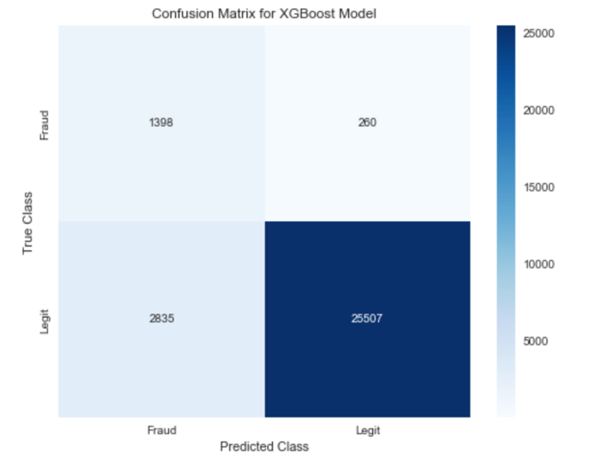
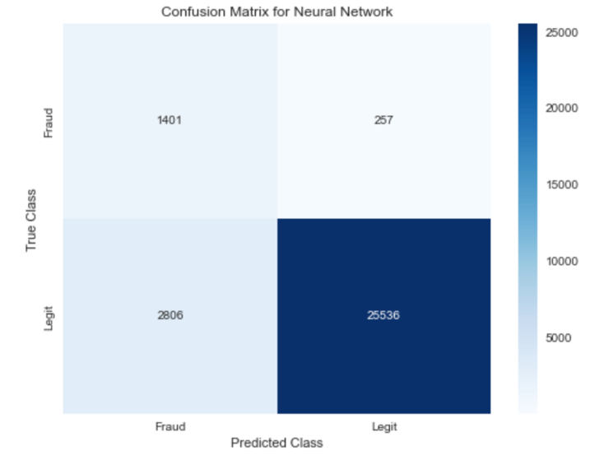
RESULTS
Notes:
We set the baseline model to have a recall of 0.85 and calculate the respective metrics using the confusion matrix. Then, we increase recall to 0.9 for the XGBoost model and to 0.901 for the Neural Network model, and calculate the metrics in the same way.

Slide 12
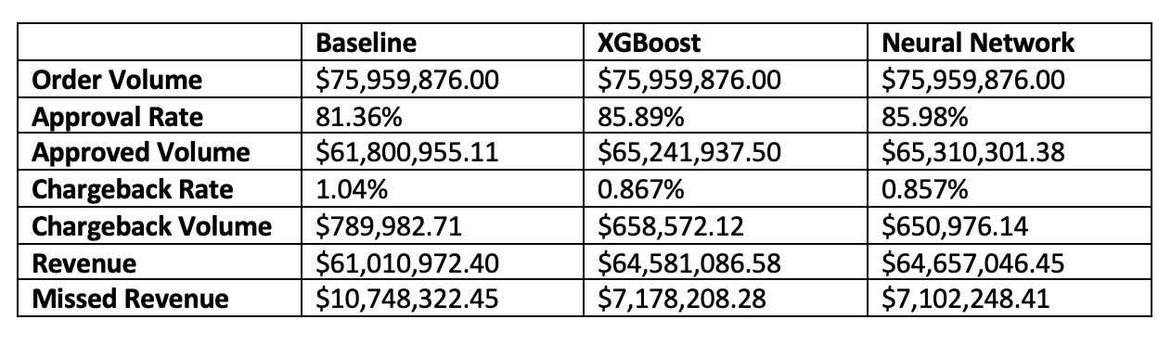
RESULTS
Notes:
This table shows the metrics comparison between the baseline model and the 2 best performing machine learning models. The Neural Network model resulted in an increase of over $3,646,000 in revenue or 4.8%, and almost $140,000 decrease in chargebacks or 0.18% compared to the baseline model.

Slide 13
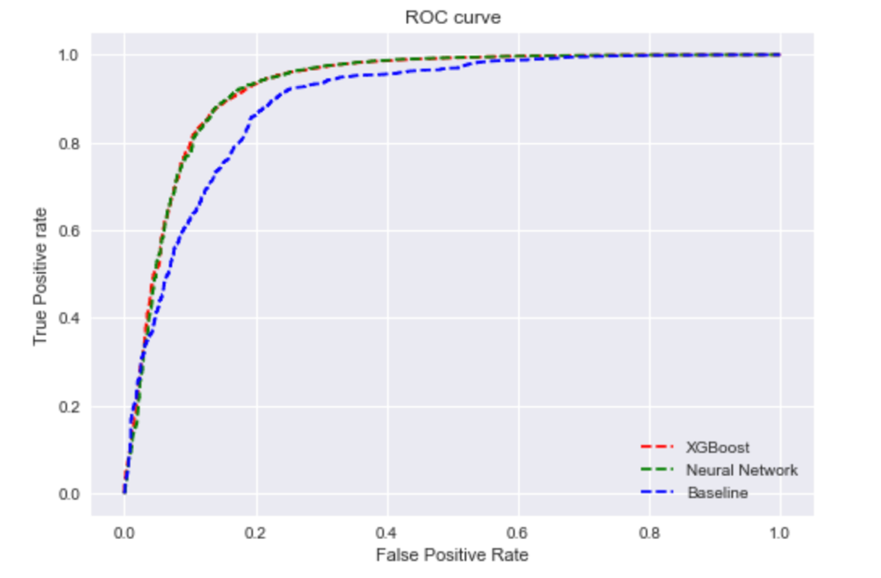
RESULTS
Notes:
Looking at the ROC curves of each of the models, we can see that the XGBoost model and the Neural Network model have similar performances, and both outperform the baseline model quite significantly.

Slide 14

CONCLUSION
Notes:
We found that the best performing model is a Neural Network model with 1 hidden layer, with the XGBoost model as a close second.
The results of our model show that we were successful in improving our fraud detection capabilities. The increase in revenue means that not only did our overall approval volume go up, but the volume of correctly approved orders went up as well. The decrease in chargebacks shows that our model also more accurately predicted fraudulent orders.

